Slide 1
Pump Up Your Marketing
Your Guide To Making The Most
Of Membership

Slide 2
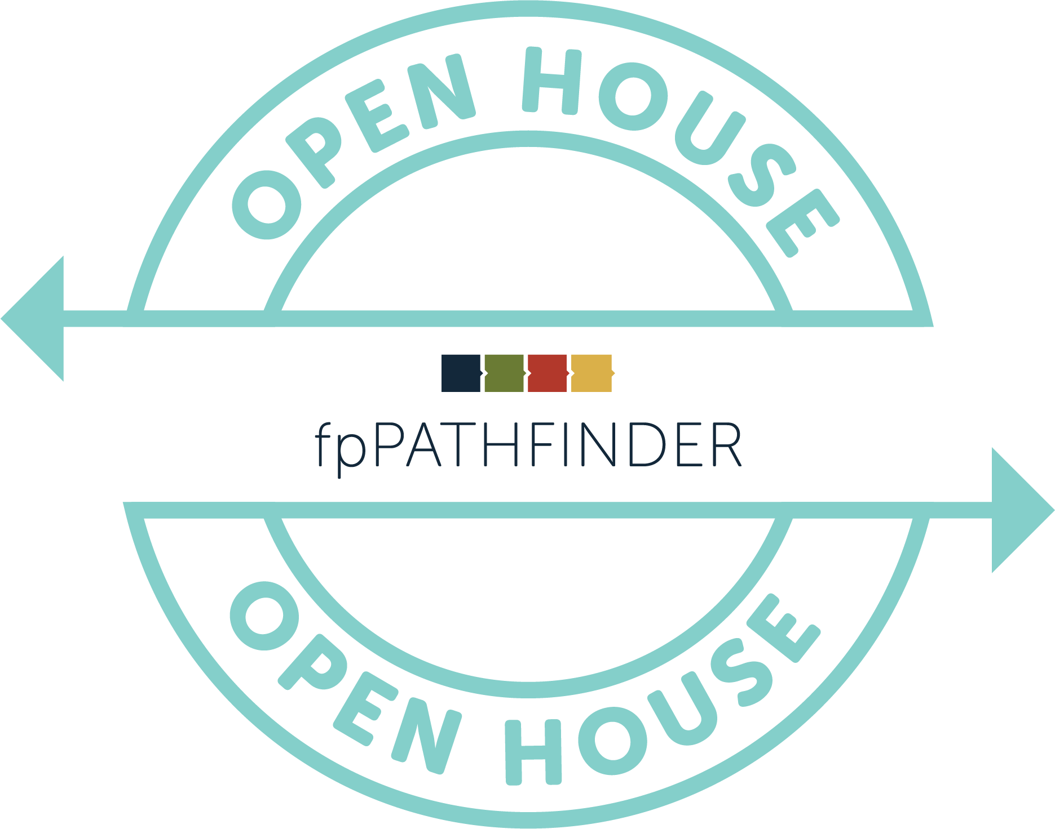
Agenda
fpPathfinder Overview
Goal Setting
Tie Marketing Tactics & Execution To Goals
Q&A

Slide 3
fpPathfinder Overview
Mike Lecours, CFP, co-founded fpPathfinder in 2018 to help advisors become more diligent in their planning processes
Currently fpPathfinder serves 3,000 advisors
The product development team works to release 1 – 2 new checklists or flowcharts every month

Slide 4
~ Peter Drucker

Slide 5
The Importance of Specific, Measurable Goals
Have actionable conversations with 20 leads with equity compensation packages.
Receive 10 qualified leads from my Centers of Influence
Establish myself as the thought leader for Young Professionals

Slide 6
GOAL: Have actionable conversations with 20 leads who have equity compensation packages.
Primary Marketing Tactic: Gated Content
Trade access to content for information
White labeled checklists and flowcharts are ideal for gated content

Slide 7
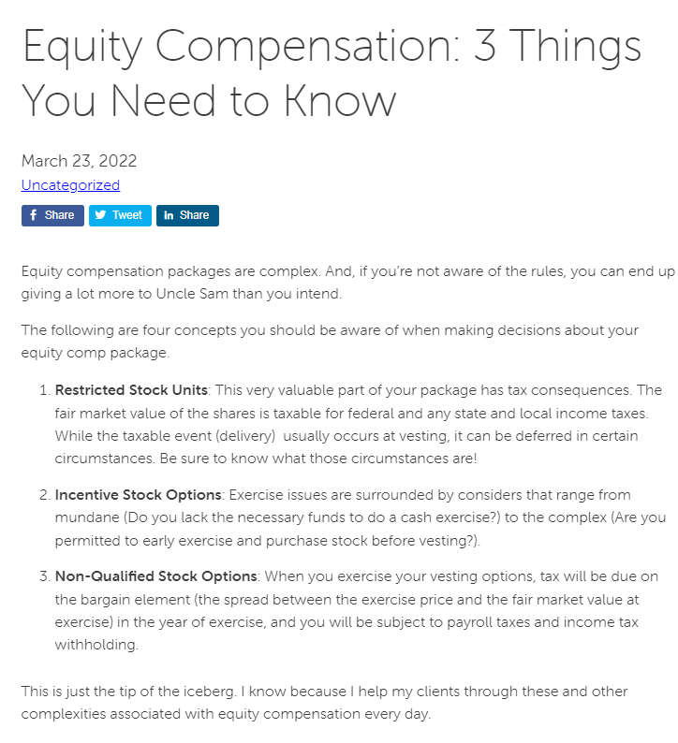
Primary Marketing Tactic: Gated Content
Execution, Step 1: Develop a blog post that provides an overview of equity compensation complexities.

Slide 8
Primary Marketing Tactic: Gated Content
Execution, Helpful Hint: Use the fpPathfinder Equity Compensation Bundle to guide your content.

Slide 9
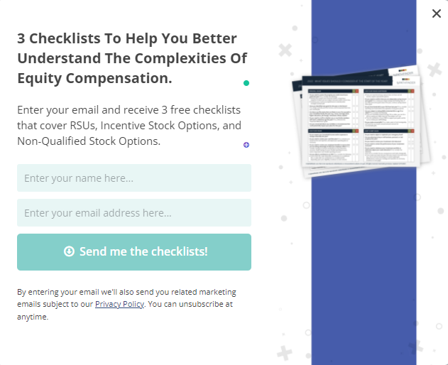
Primary Marketing Tactic: Gated Content
Execution, Step 2: Create a popup invitation to receive the Equity Compensation checklists and flowcharts you’ve chosen.

Slide 10
Primary Marketing Tactic: Gated Content
Execution, Step 3: Promote your blog post repeatedly.
social media
newsletters

Slide 11
Primary Marketing Tactic: Gated Content
Execution, Step 4: Nurture your leads
Consider implementing an email sequence of 3 – 4 messages that addresses an equity compensation issues with a call to action to book a call with you.
Add the emails you collect to your newsletter list to create ongoing awareness.

Slide 12
GOAL: Receive 10 qualified referrals from my centers of influence.
Primary Marketing Tactic: Collateral
Collateral helps you tell a consistent story to centers of influence
White labeled checklists and flowcharts are ideal to share as collateral to generate referrals

Slide 13
Primary Marketing Tactic: Collateral
Execution, Step 1: Identify the COI from whom you want to cultivate referrals and collate the relevant checklists and flowcharts (collateral) .
Accountants
Estate Planning Attorneys
Insurance Agents
Real Estate Agents

Slide 14
Primary Marketing Tactic: Collateral
Execution, Helpful Hint: Use the fpPathfinder bundles to identify groups of guides that pertain to your COI’s clients.

Slide 15
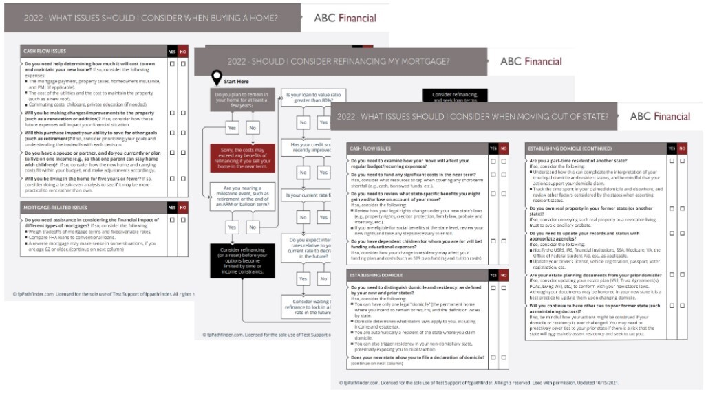
Primary Marketing Tactic: Collateral
Execution, Step 2: Walk your COI through the client experience you’ve developed using your white labeled checklists and flowcharts

Slide 16
Primary Marketing Tactic: Collateral
Execution, Step 3: Ask your COI to share the white labeled resources and a simple call to action with their clients.
Notes:
The final step, after I’ve answered any questions my COI may have, is to ask her to share my WHITE LABELED checklists and flowcharts with her clients with a simple call to action.
For example, when my Real Estate COI’s clients are deciding weather to buy a new home or are facing an out-of-state move, she can simply say: I work with Amy Burdge, and she shared this checklist with me. I’d like you to take a copy and quickly answer the questions. If you answer “YES” to anything, you may have a planning opportunity. She can help! Her phone number and email are on the checklist.
It’s really that simple. And that easy.
I should mention that I’ll also make time to follow-up periodically, ask for feedback, and listen for opportunities to complement my COI’s work.

Slide 17
GOAL: Establish myself as a thought leader for Young Professionals.
Primary Marketing Tactic: Content Marketing
Build your credibility to become recognized as an expert in your field or niche
White labeled checklists and flowcharts are ideal to support your brand and illustrate your subject mastery

Slide 18
Primary Marketing Tactic: Content Marketing
Execution, Step 1: Identify your audience
Young professionals
Women
Entrepreneurs
Physicians
And the list goes on

Slide 19
Primary Marketing Tactic: Content Marketing
Execution, Step 2: Define what action you want them to take
Visit your website
Schedule an appointment
Attend a seminar you’re hosting
Sign up for your newsletter

Slide 20
Primary Marketing Tactic: Content Marketing
Execution, Step 3: Create a content calendar
Which topics do you want to create content around
Which visuals will you use to support your work
Are there ideas that lend themselves better to written submissions, video, podcasts, or speaking engagements

Slide 21
Primary Marketing Tactic: Content Marketing
Execution, Helpful Hint: fpPathfinder’s Resource Guides and Guide Bundles can help you build a relevant content calendar with agency-level visuals to support your work.

Slide 22
Primary Marketing Tactic: Content Marketing
Execution, Step 4: Begin Creating
Set aside time every day to be creative
Set deadlines for yourself
Pitch your niche
Be your own PR machine, and leverage social media

Slide 23
A Recap
Establish goals that are specific and measurable.
Tie your marketing efforts to your goals
Track your results
Have some fun

Slide 24
fpPathfinder Membership Options
Essentials: $99 / year / user
Deluxe: $299 / year / user
Premier: $499 / year / user
Ensemble: Email support@fpPathfinder.com

Slide 25
Questions?
Marketing: email Amy@fpPathfinder.com
Member Services: Support@fpPathfinder.com

